Slide 1
DASMA Thermal Performance Verification Program

Slide 2
Introduction
DASMA Sponsors a Thermal Performance Verification Program for Sectional Garage Doors
The Most Influential Manufacturers That Produce Insulated Sectional Doors, Representing the Overwhelming Majority of Sales, are Participating
Significant Effort Over Many Years was Invested to Design and Implement the Program

Slide 3
Introduction
The Program Represents a Shift in How Sectional Garage Door Thermal Performance is Rated
All Participants and DASMA Have Agreed to Migrate to Use of U-Factor Instead of R-Value
The Program Also Enlists Third Party Test Labs and an Independent Program Administrator

Slide 4
Why Have a Program?
The Garage Door Industry Needs to Provide Credible Thermal Performance Ratings
Everyone-Manufacturers, Specifiers, Customers, and Dealers - benefits from uniform and consistently applied rating methods
As With Windload, Enforcement is Coming
The Industry Can Control Its Own Destiny

Slide 5
Why Verified U-Factor?
U-Factor is an Actual, Tested Thermal Performance Measurement
Architects and Specifiers are familiar with U-Factor
U-Factor is used by related industries: Windows, Entry Doors, Skylights

Slide 6
Why Verified U-Factor?
U-Factor and Credible, Verified Ratings are expected to be required in the future
U-Factor is a more accurate way to rate thermal performance than the currently used R-Value
Tested with U vs Calculated with R
Whole Installed Assembly with U vs Portion of Section Insulation with R
Equitable Basis for Comparison
Third Party Testing & Verification Lends Credibility

Slide 7
What is U-Factor?
U-Factor is a measurement of heat transfer or flow through, in our case, a garage door
Higher heat transfer is generally “bad” as it results in greater loss of energy, either from heated or cooled air
A lower U-Factor, which indicates less heat transfer, is better than a higher U-Factor

Slide 8
How is U-Factor Determined?
U-Factor is measured in a specialized chamber
An assembled door is sealed in the chamber opening
Heat transfer through the door is measured with sensitive equipment
Test requirements and procedures are contained in the ANSI/DASMA 105 standard

Slide 9
How is U-Factor Different From and Better Than Other Thermal Ratings
R-Value is resistance to heat transfer. It is not the inverse of U-Factor (in our industry) R-Value ≠1/U-Factor
R-Value represents only a small portion of insulation in a garage door section, not an entire assembled door

Slide 10
How is U-Factor Different From and Better Than Other Thermal Ratings
R-Factor and U-Value are just calculations, not real rating methods, and have no technical basis
U-Factor is an actual test of a whole, installed door, not just a calculation based on a small portion of a door

Slide 11
Participant Ratings
Participants in the DASMA Thermal Performance Verification Program:
must publish a U-Factor for all highly thermally efficient sectional doors
may publish, but are not required to publish, an R-Value
are not permitted to use any other means of stating thermal performance for any door, listed in the program or not

Slide 12
What Doors Are Covered?
Only Sectional Doors
Highly Thermally Efficient Sectional Doors Must be Listed. These Doors Have
an insulated core
a meeting rail design that incorporates a thermal break
glazing cutouts of 16% or less of the total door surface area
Other sectional doors may be listed in the program, as well

Slide 13
Program Requirements for Participants
Participants in the Program:
Sign Agreements to Enter the Program
Conduct Tests at Third Party Test Labs Using ANSI/DASMA 105
Certify Thermal Performance for Door Models Entered in the program
Submit Tests and Certifications to the Program Administrator
Abide by All Program Rules

Slide 14
Program Requirements for Participants
Intertek Serves as the Program Administrator
Collects Certifications and Test Reports
Publishes Directory of Listed Models
Verifies Continued Compliance with Program Rules Through Regular Audits
DASMA Owns the Program and Provides Administrative and Governance Support

Slide 15
Program Mark
INSERT SMALLER VERSION OF MARK WHEN COMPLETE
Used only by DASMA and Participants

Slide 16
Program Mark
Indicates Participation in Program
Can Be Used to Identify Listed Products
There are Regulations Governing Proper Use
Cannot be used with non-listed products
Can only be used if all program requirements are met

Slide 17
Program Mark
Two Versions, Related Styles
Look for the DASMA program mark to confirm legitimate thermal performance, verified by 3rd party independent testing labs

Slide 18
Program Temporary Product Label
Optional
Placed on Sections Only
Not Permitted on Packaging
May Include R-Value as Shown on Example

Slide 19
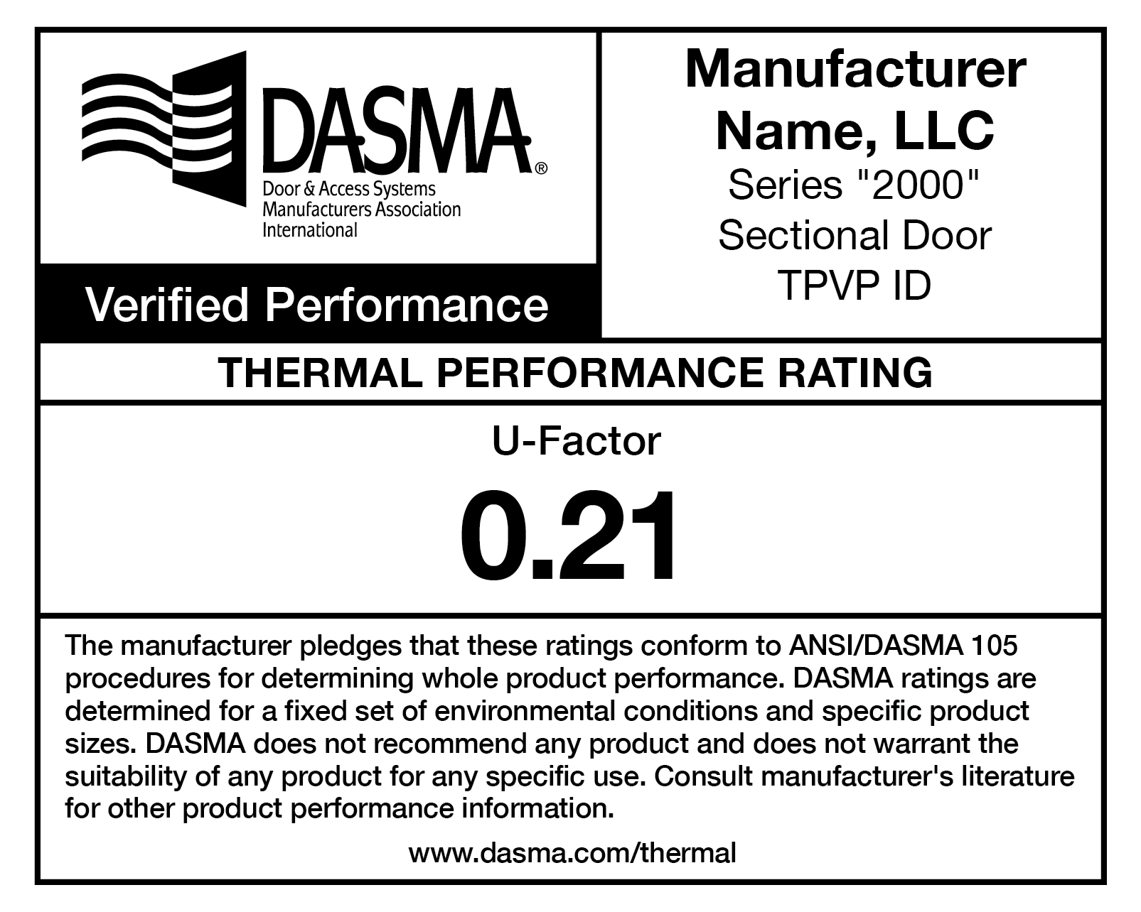
Program Temporary Product Label
UPDATE WITH FINAL LABELS

